Slide 1


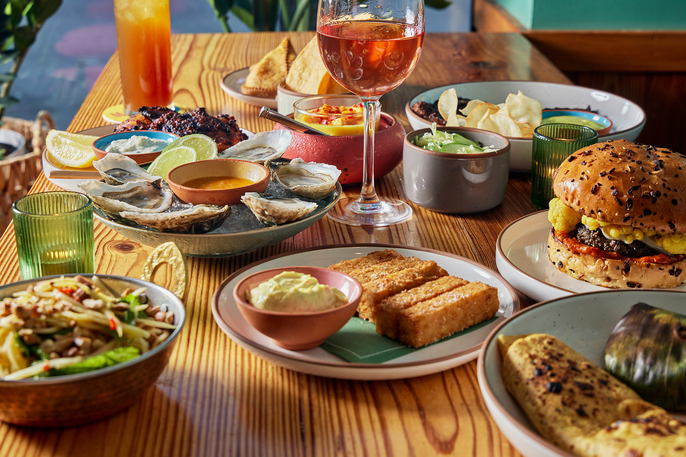

Street Food & Local Eats Guide
Data Management and Database Design
Group - 6
Harshitha Chandrashekar
Suhas Shetty
Yash Zaveri
Rishabh Shah
Rahul Pothirendi

Slide 2
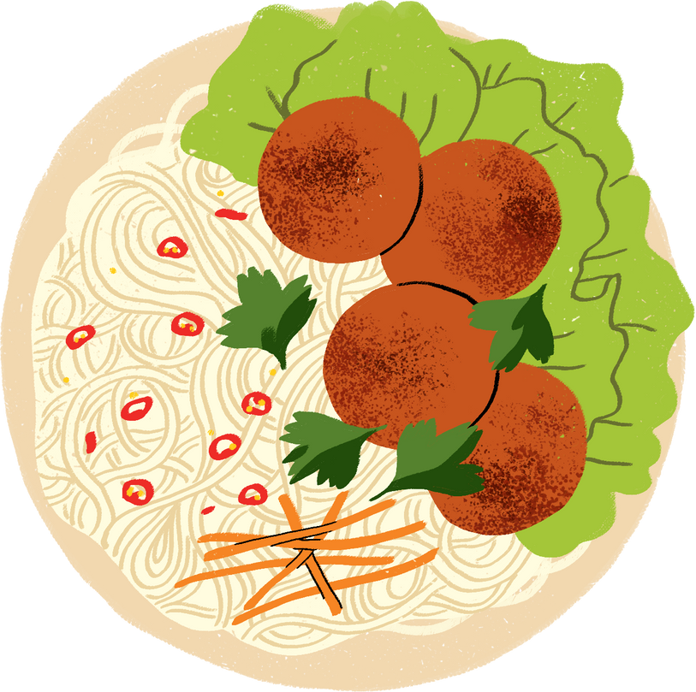

OBJECTIVE
1
2
3
Create an Extensive Culinary Database:
Empower Small Food Ventures:
Elevate User Experience:
4
5
Foster Culinary Exploration:
Boost Local
Economy:

Slide 3


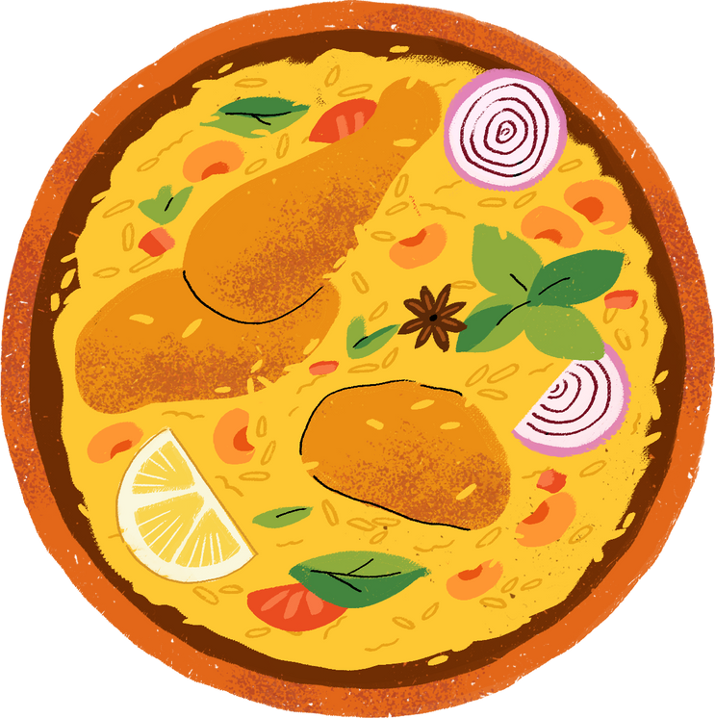
GOALS
GOAL - 1
GOAL - 2
Comprehensive Cuisine Catalog:
Establishing a centralized repository of diverse culinary options, providing users with easy access to a wide array of cuisines and local eateries.
User-Friendly Interface:
Developing an intuitive and streamlined platform interface for efficient navigation and management of restaurant information, saving users' time and enhancing their dining experiences.
GOAL - 3
GOAL - 4
Personalized Recommendations:
Implementing an advanced recommendation system that analyzes user preferences and dining habits to offer tailored suggestions, thus providing a unified experience for all users seeking culinary exploration.
Seamless Integration:
Integrating various aspects of restaurant management, including menus, reviews, ratings, and health inspection results, into a cohesive system, ensuring a seamless and holistic dining experience for users.

Slide 4

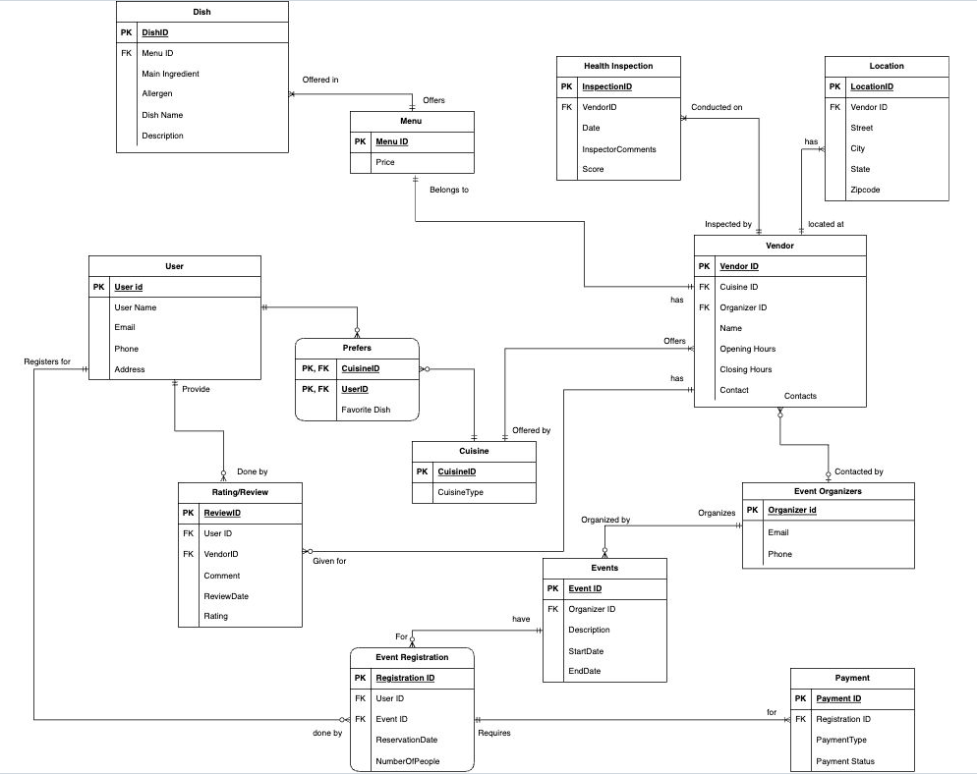


ERD

Slide 5
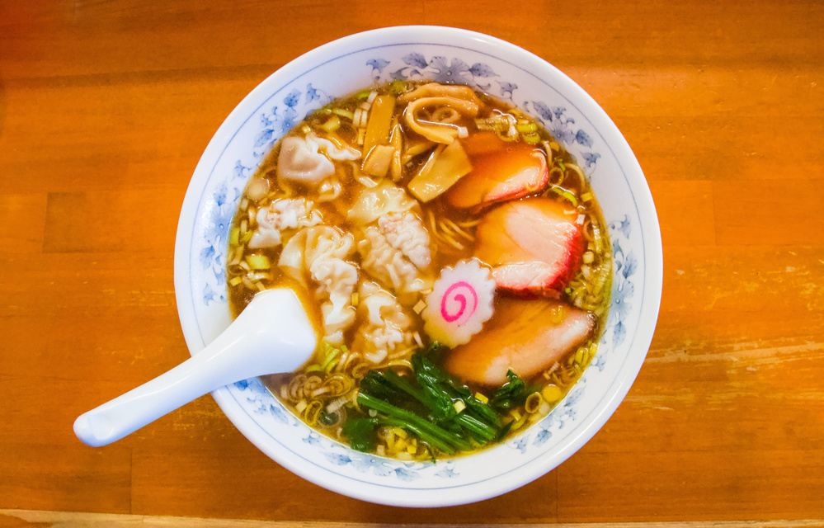
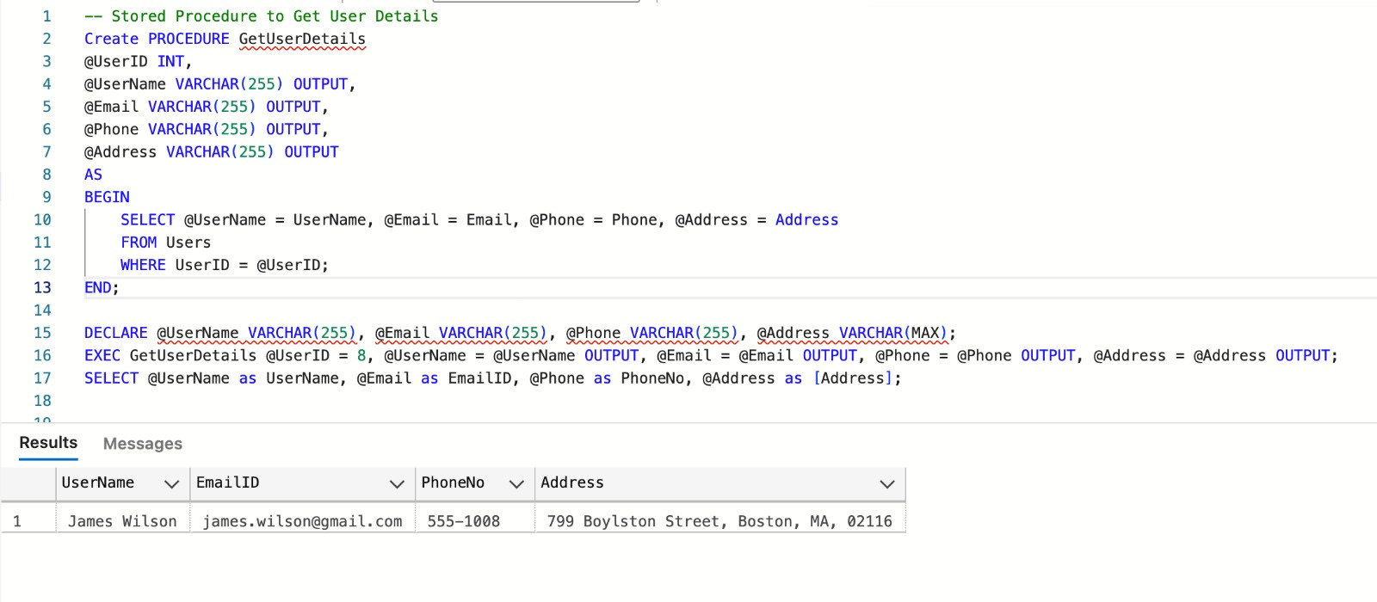
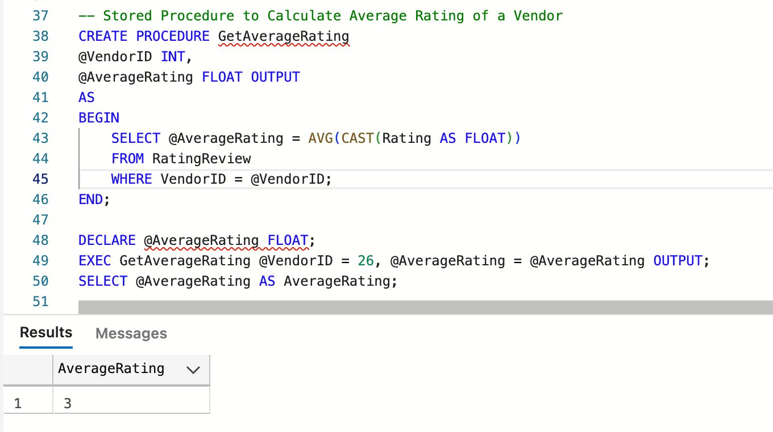
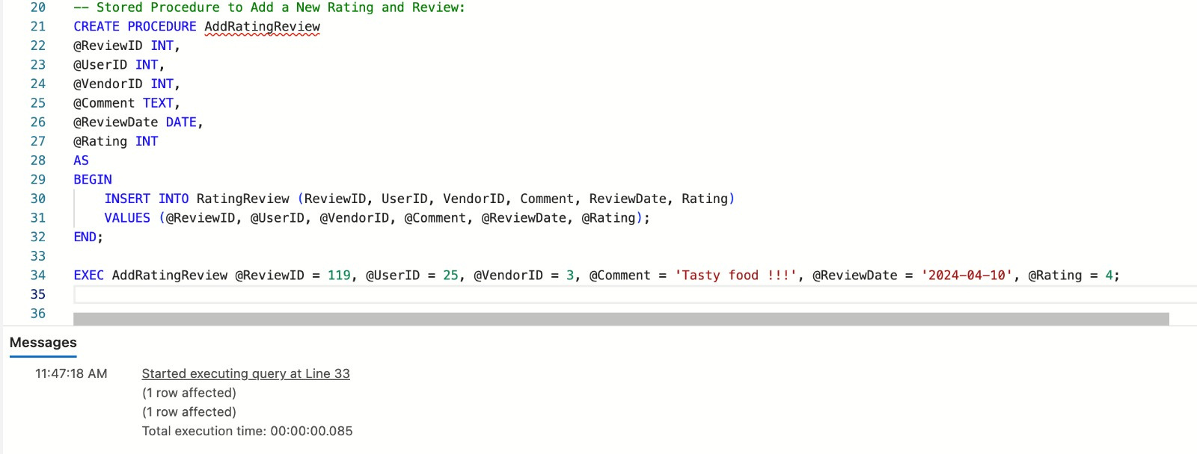
STORED PRODECURE
GETUSERDETAILS:
GETAVERAGERATING:
ADDRATINGREVIEW:

Slide 6

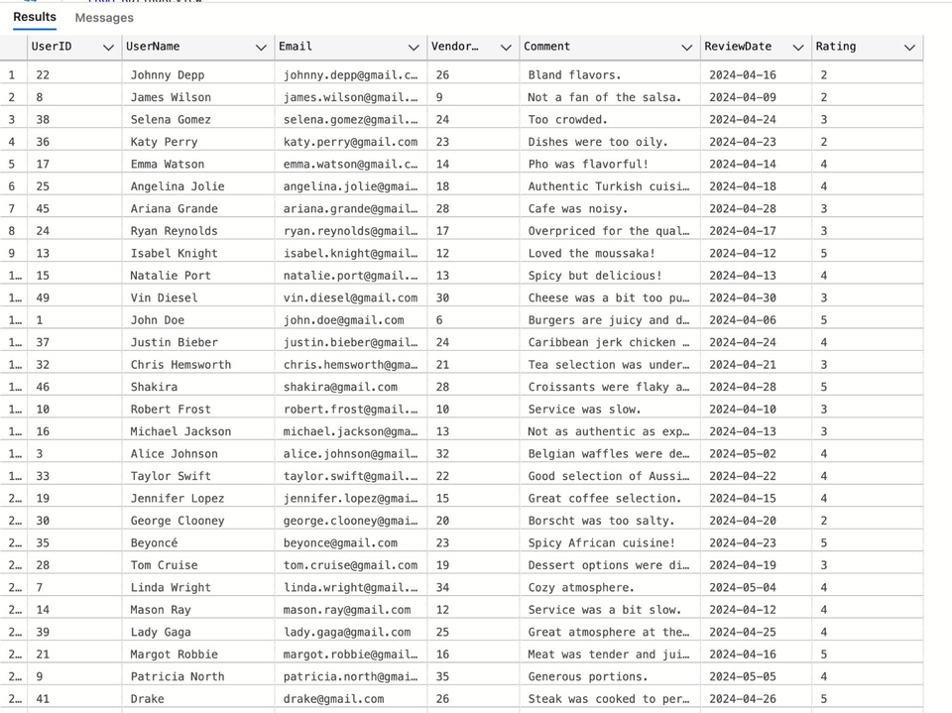
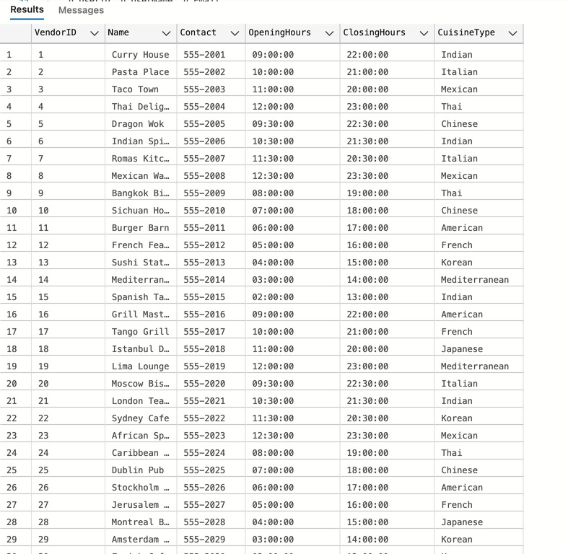
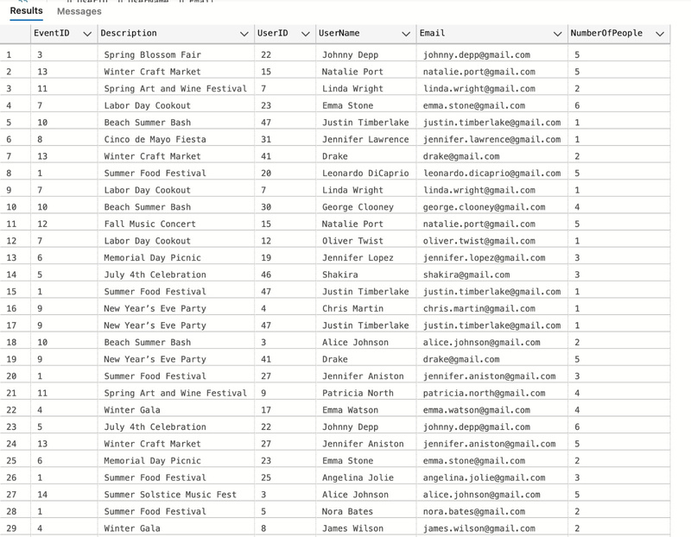
VIEWS
USER
VENDOR
EVENT

Slide 7


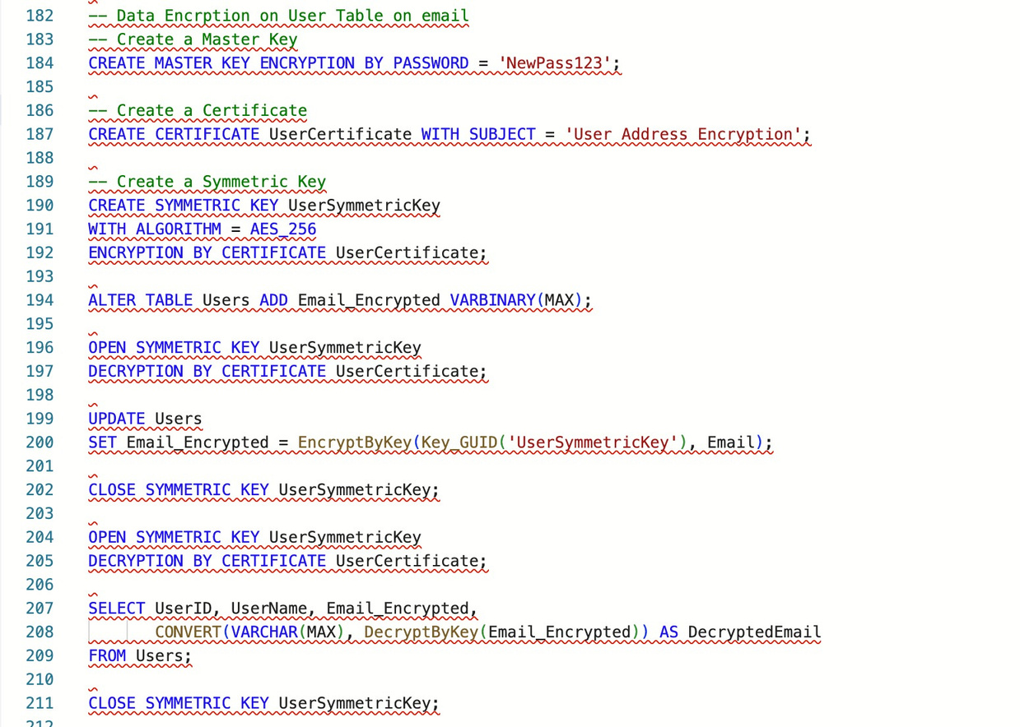
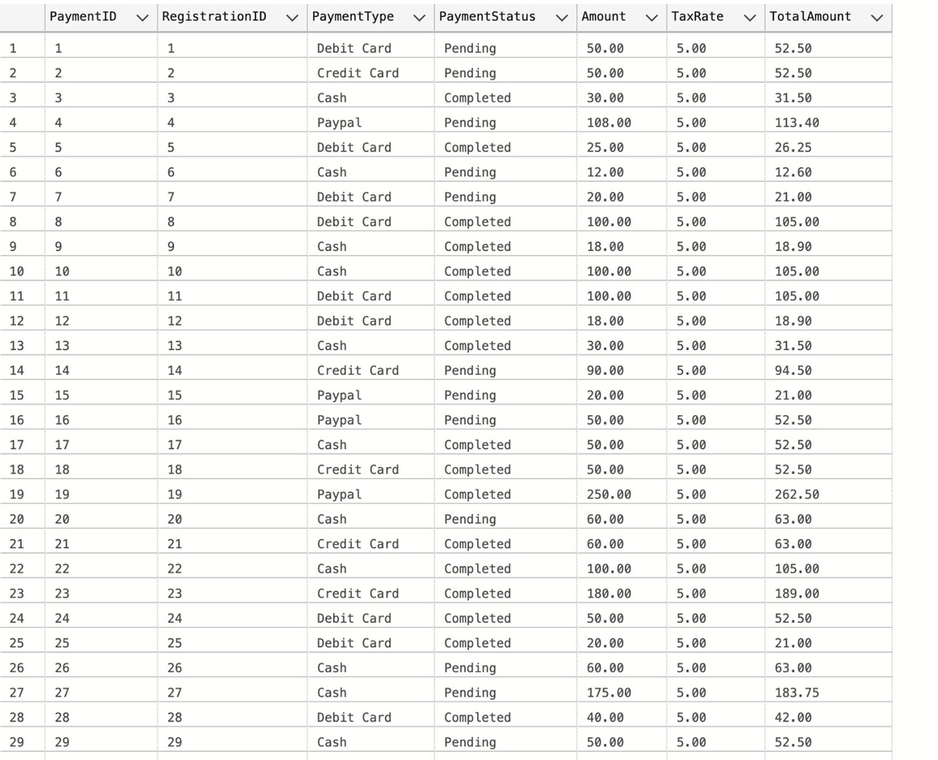
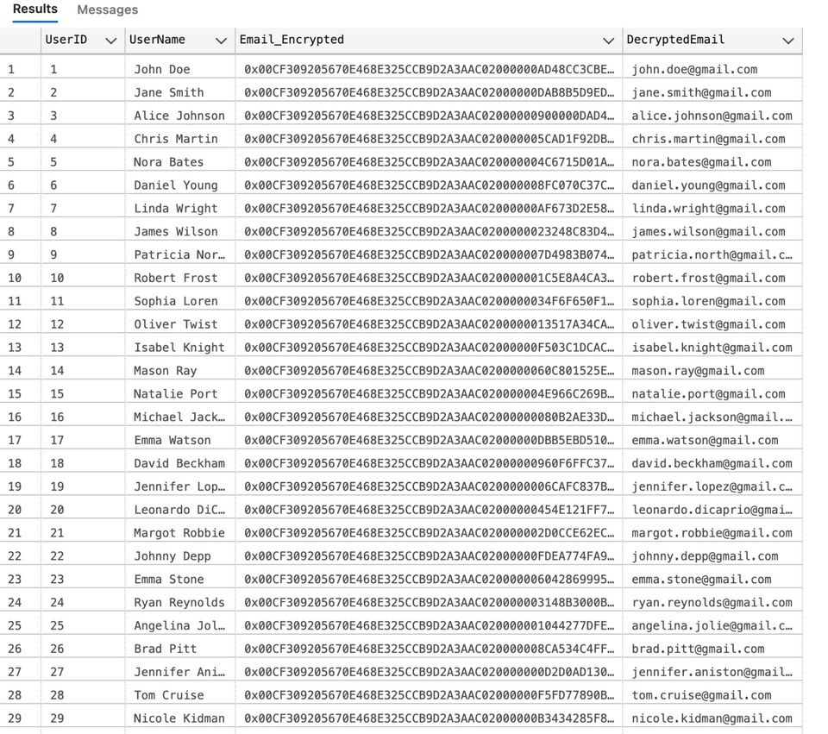
ENCRYPTION
USER- DEFINED FUNCTION
(UDF)

Slide 8
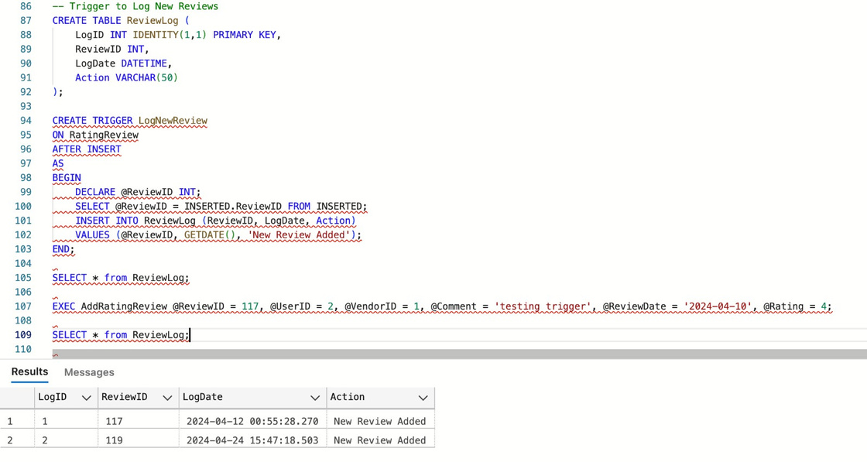
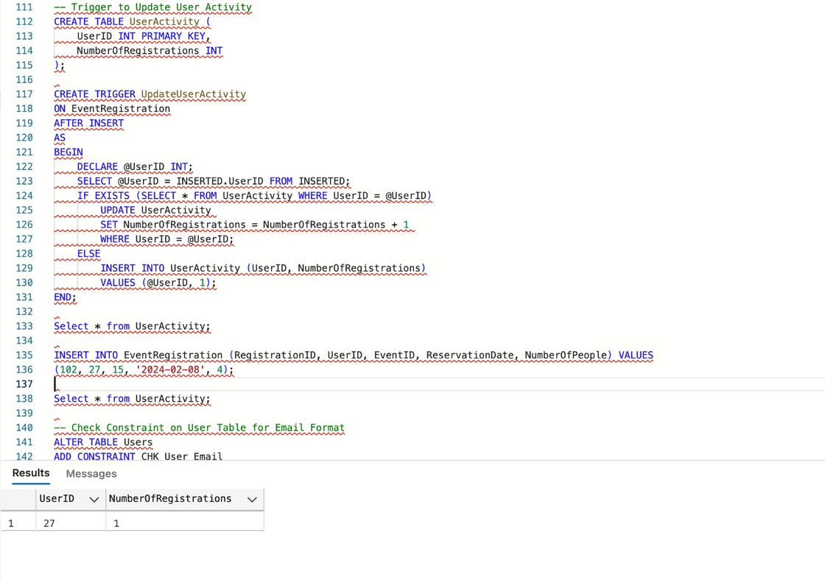
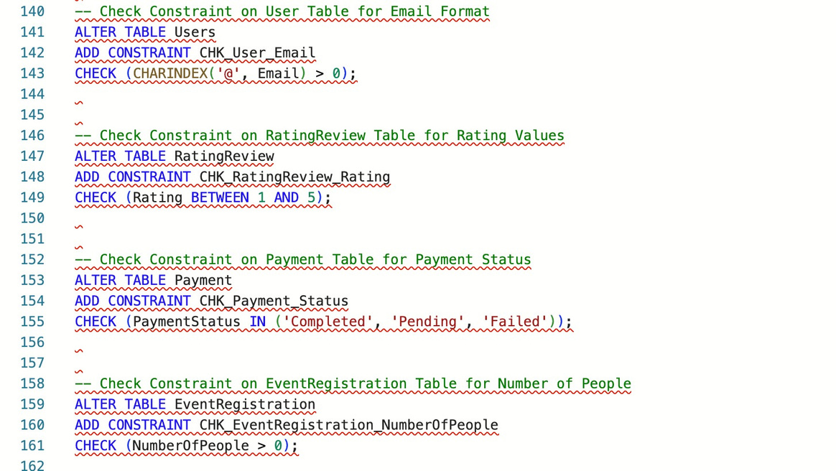
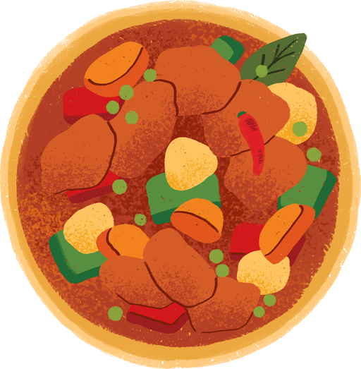
TRIGGERS
CONSTRAINTS

Slide 9

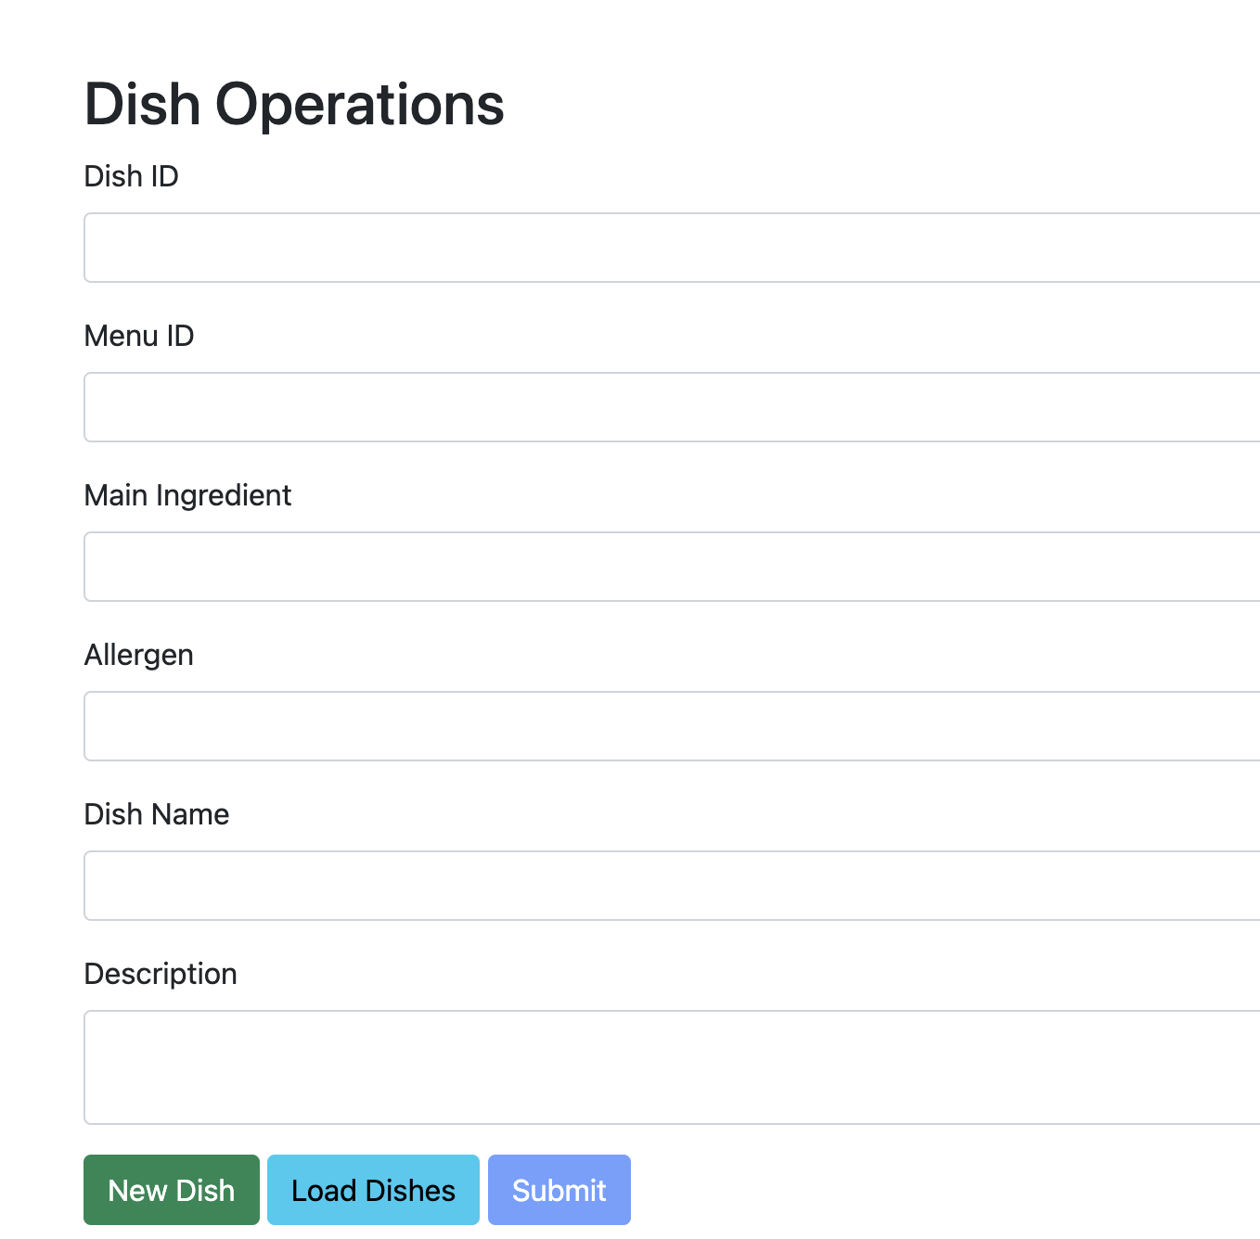
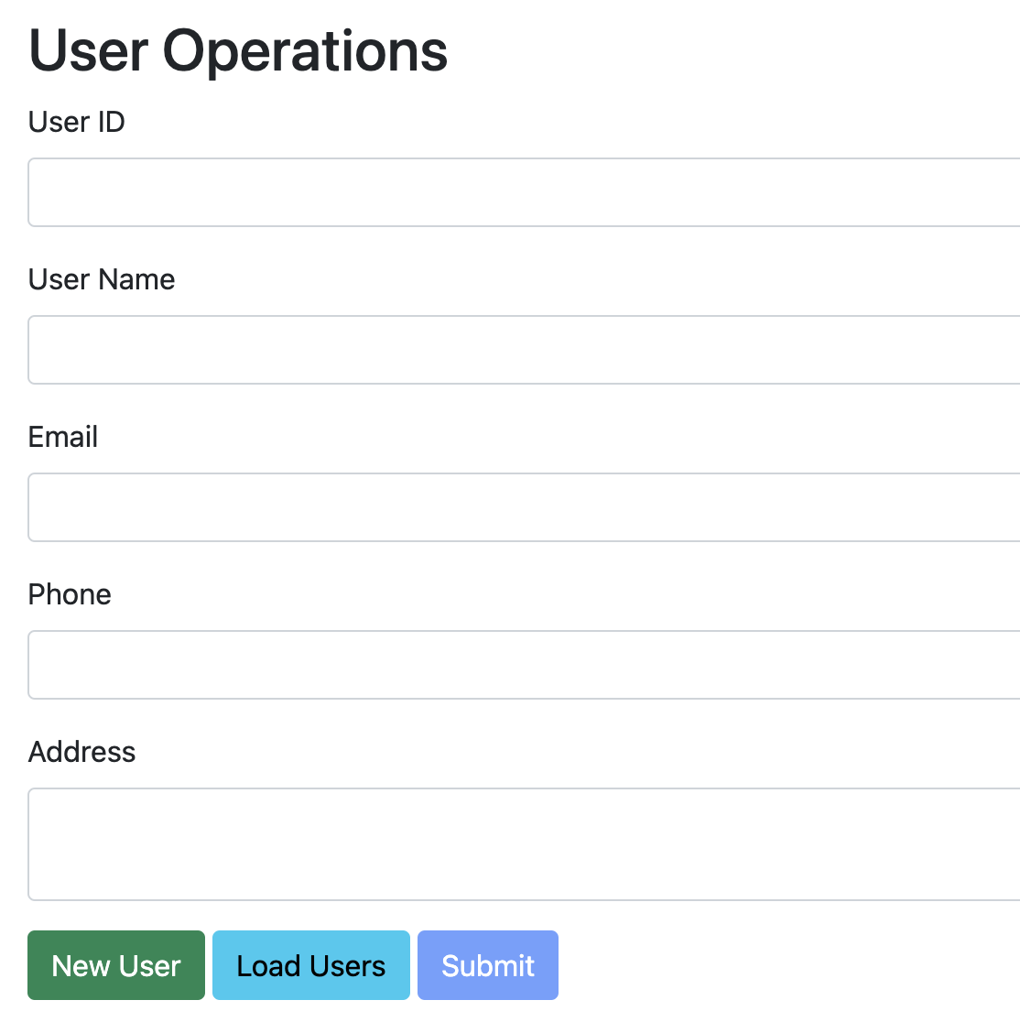
GUI

Slide 10


Thank you
END

